Slide 1

Managing Analytics Project in
Part 0 of Analytic with Tidyverse series
Prepared by : Aep Hidayatuloh
Email : aephidayatuloh.mail@gmail.com
GitHub : https://github.com/aephidayatuloh
RPubs : https://rpubs.com/aephidayatuloh

Slide 2



{Aep Hidayatuloh}
Nama Panggilan | : Aep
Daerah Asal | : Cikarang, Bekasi
Tempat Tinggal | : Cikarang, Bekasi
Angkatan | : STK 46
Pekerjaan | : - Senior Data Analyst at Starcore Analytics
 | - Customer Value Management at PT Asuransi Jiwa Sequislife
 | - Statistician & App Developer at PT Ganesha Cipta Informatika
Github | : https://github.com/aephidayatuloh
Email | : aephidayatuloh.mail@gmail.com
Rpubs | : https://rpubs.com/aephidayatuloh
telegram community
R Indonesia
https://t.me/GNURIndonesia

Slide 3
{Prerequisite}
Internet Connection
Basic R Knowledge
Software Installed:
R program [https://cran.r-project.org/]
RStudio [https://www.rstudio.com/products/rstudio/download/]
Data & Scripts:
Download from https://github.com/aephidayatuloh/managingproject
R Packages:
base : built-in base installed R
Use install.packages("<pkgname>") to install required packages.

Slide 4
What Will Be Discussed?

Slide 5
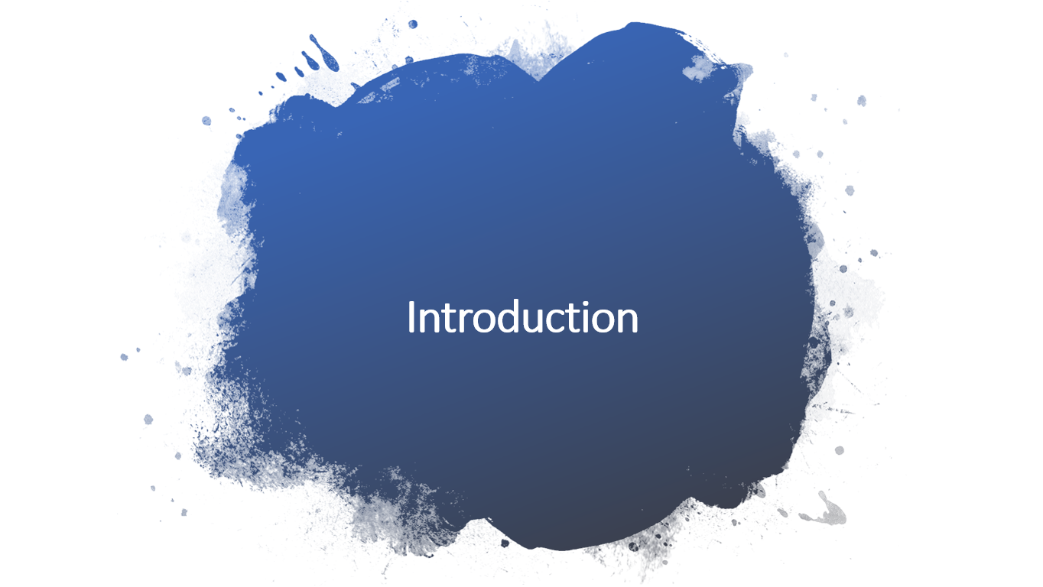
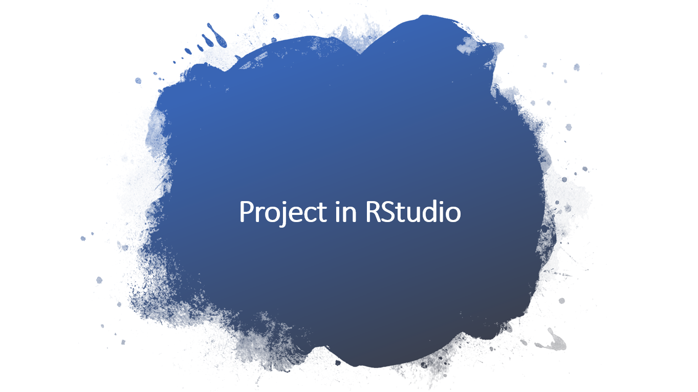
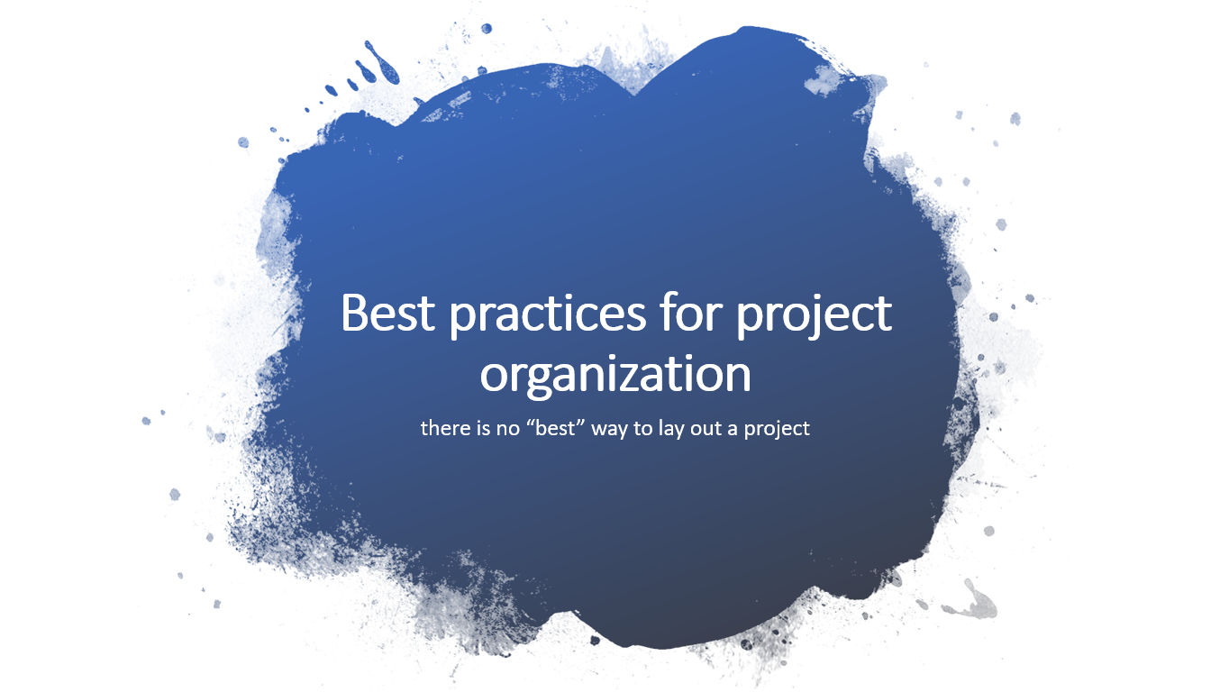
Outline

Slide 6
Introduction

Slide 7
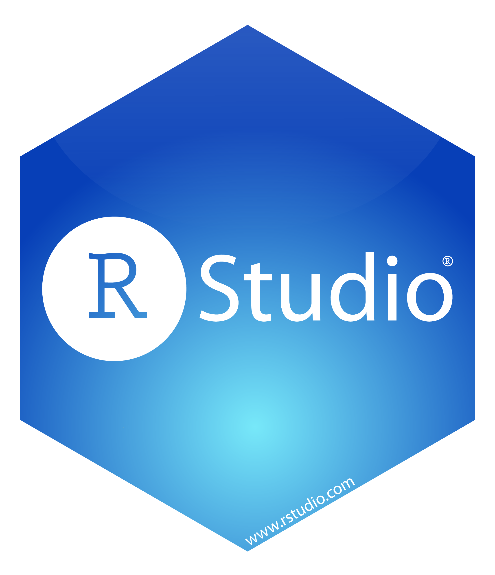
Welcome to RStudio
is one of most used Integrated Development Environment (IDE) for R that makes it easy to build R script in more interactive mode.
i.e. auto-complete code, organized panel and many more useful functional.
RStudio is available in two formats:
RStudio Desktop -> program is run locally as a regular desktop application;
RStudio Server -> allows accessing RStudio using a web browser while it is running on a remote Linux server.
RStudio Desktop and RStudio Server are both available in free and fee-based (commercial) editions.
Download latest version of RStudio [https://www.rstudio.com/products/rstudio/download/]

Slide 8
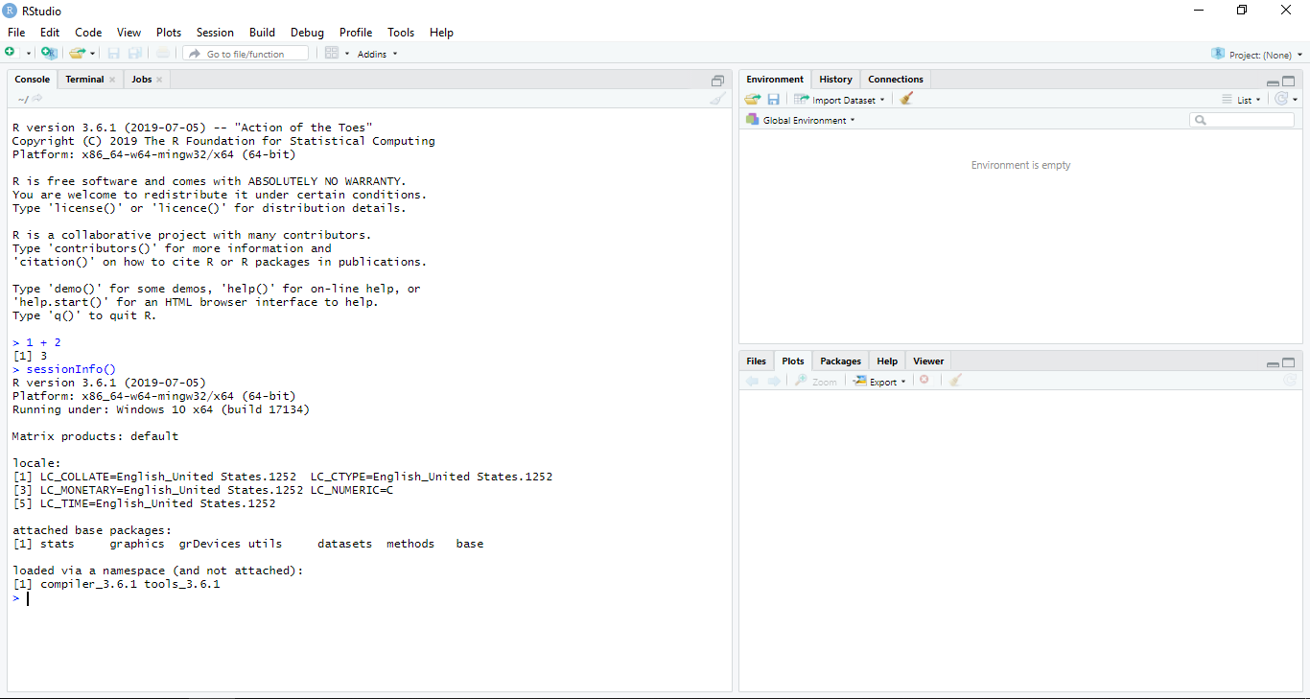
RStudio
Console/Terminal/Jobs
Environment/History/
Connections
Files/Plots/Packages/
Help/Viewer

Slide 9
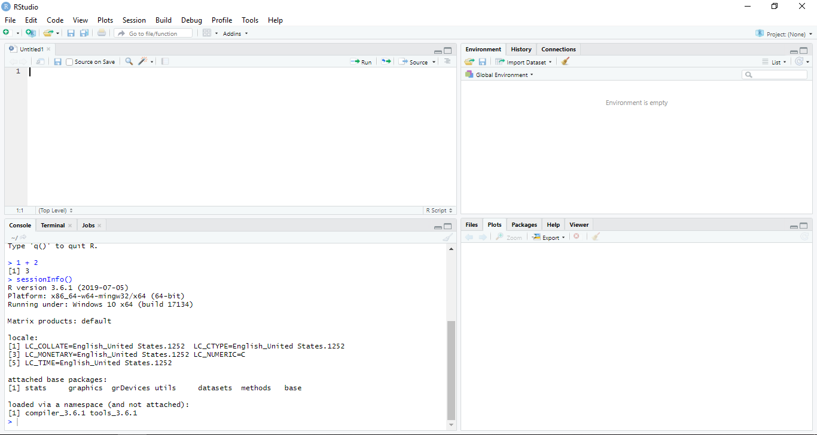
RStudio
Script Editor
File -> New File -> R Script
(Ctrl + Shift + N)
Environment/History/
Connections
Console/Terminal/Jobs
Files/Plots/Packages/
Help/Viewer

Slide 10
Outline

Slide 11
Project in RStudio

Slide 12
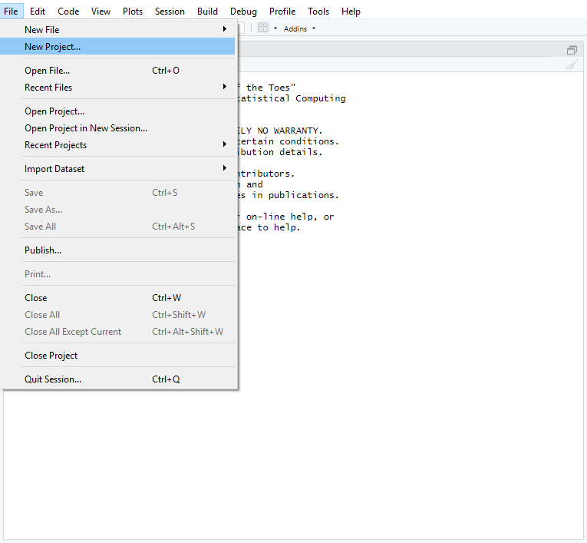
New Project

Slide 13

New Project

Slide 14
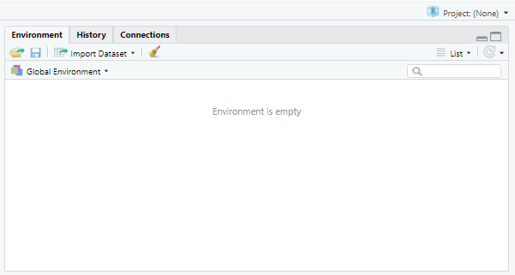
New Project

Slide 15
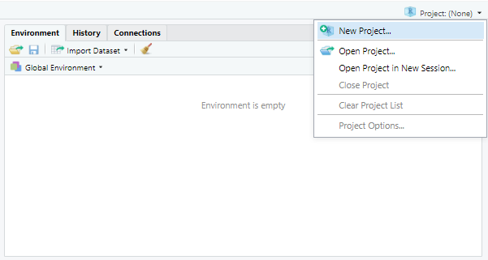
New Project

Slide 16
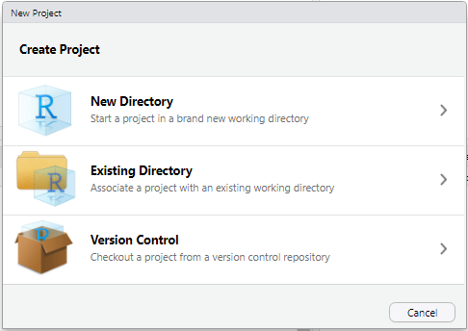
New/Existing Directory

Slide 17
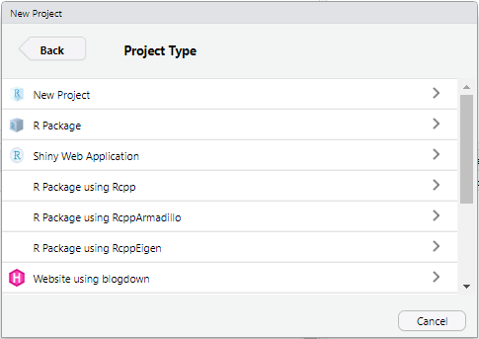
Project Type

Slide 18
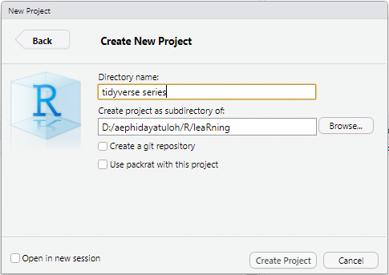
Project Name and Directory

Slide 19
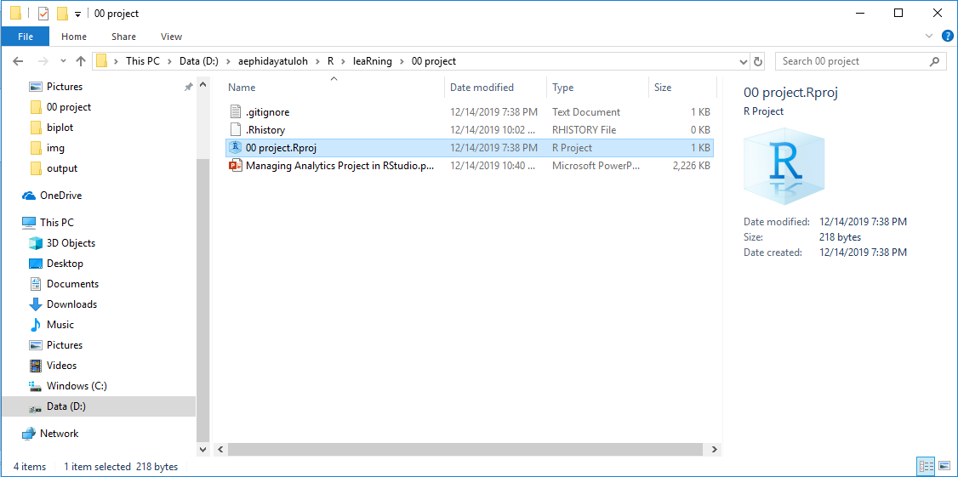
New Project Structure

Slide 20
Challenge 1
Challenge: Creating a self-contained project
We’re going to create a new project in RStudio: Click the “File” menu button, then “New Project”. Click “New Directory”. Click “New Project”. Type in the name of the directory to store your project, e.g. “my_project”. If available, select the checkbox for “Create a git repository.” Click the “Create Project” button.

Slide 21
Outline

Slide 22
Best practices for project organization
there is no “best” way to lay out a project

Slide 23
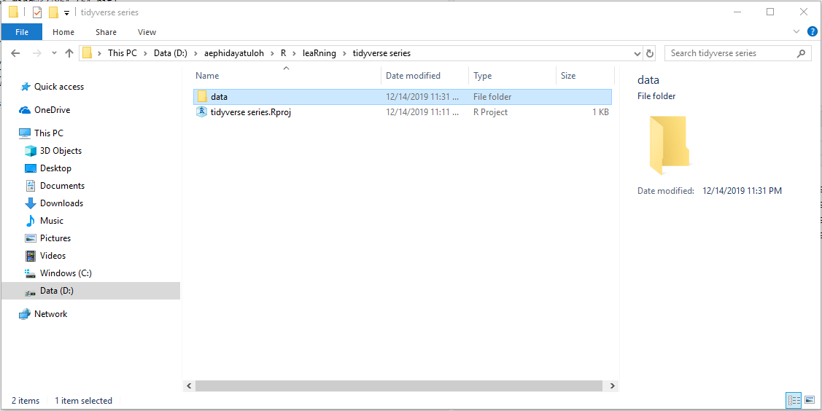
Treat Data As "Read Only"
If you have external file(s) as input data → create data folder
Do not modify the original data!

Slide 24
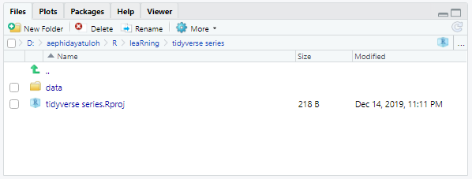
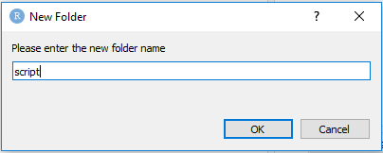
R Script
Create script or src folder for R or other script and anything related to it.
Name file (not only script) with history-like, for changes
Save-as script.R as script_20191201.R
Edit the script.R file as the last updated script

Slide 25
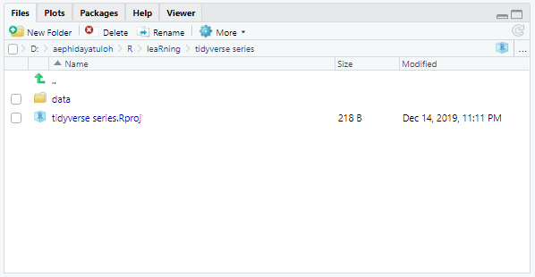
Function Definition Script
Separate function definition script and application script where it used.

Slide 26
Output
Create output folder for all output
Do not modify output file directly → copy then modify!
Documents
Create docs folder for all document associated with the project.

Slide 27
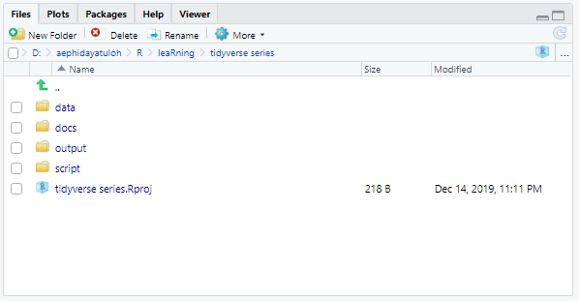
Summary
Key Point
Use RStudio to create and manage projects with consistent layout. Create folder for data, script, output, documents, etc. Treat raw data as read-only. Treat generated output as disposable. Separate function definition and application.

Slide 28
??? {Q & A}

Slide 29
ThankQ

